Slide 1
Time Domain Analysis of
Control Systems
Chapter 3

Slide 2
Reviews
Transient Response
  Approximation of High-Order Systems
Basic concept about root loci
Rules for constructing root loci
  Start and end point
  Number of branches
  Asymptotes
  Symmetry
  Root loci on real axis
  Breakaway points
  Angles of departure and arrival
  Intersection with the imaginary axis

Slide 3
Outlines
Root loci change after adding zeros or poles
Basics about frequency domain analysis

Slide 4
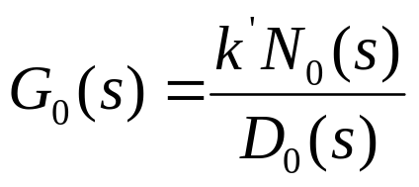

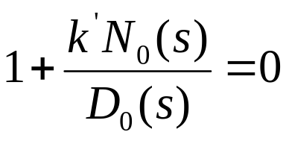
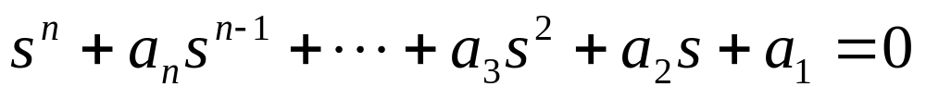
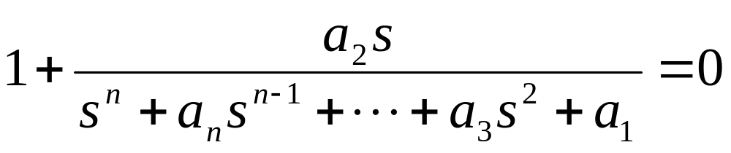

Parameter Design Using Root Locus Method
Root loci are the trajectories of roots of system characteristic equation when k’
varies from 0 to infinity. The characteristic equation is:
if
then, the characteristic equation is rewritten as:
If we have a characteristic equation and want to study the impact of the variation
of a coefficient to the characteristic equation, we can use the root locus method.
If want to study

Slide 5
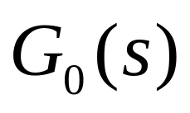


Adding Poles and Zeros to
The characteristic equation:
The characteristic equation after adding poles or zeros:
Three cases:
1. Adding poles;
2. Adding zeros;
3. Adding zero-pole pairs;

Slide 6
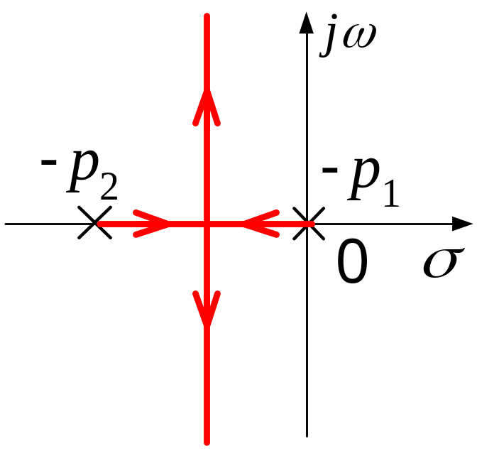

Effects of Adding Poles
Adding a pole to the left
j
ω
-
p
-
p
-
p
3
2
1
0
σ
Adding a pole to has the effect of pushing the root loci toward the
right-half plane.

Slide 7
Effects of Adding Poles
Adding a pole in the middle
j
ω
-
p
-
p
-
p
2
3
1
0
σ
Adding a pole to has the effect of pushing the root loci toward the
right-half plane.

Slide 8
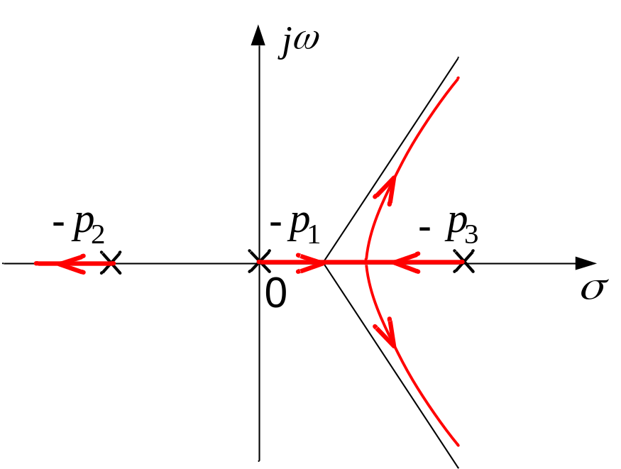
Effects of Adding Poles
Adding a pole to the right
Adding a pole to has the effect of pushing the root loci toward the
right-half plane.

Slide 9
Effects of Adding Zeros
Adding a zero to the left
j
ω
-
z
-
p
-
p
1
2
1
0
σ
Adding a zero to has the effect of pushing the root loci toward the
left-half plane.

Slide 10
Effects of Adding Zeros
Adding a zero in the middle
j
ω
-
p
-
z
-
p
2
1
1
0
σ

Slide 11
Effects of Adding Zeros
Adding a zero to the right
j
ω
-
p
-
p
-
z
2
1
1
0
σ

Slide 12
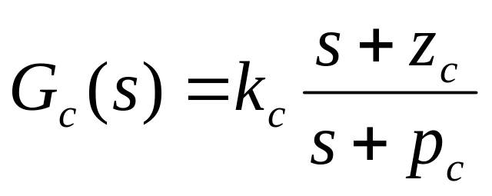
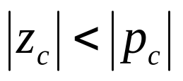
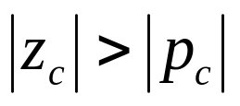
Effects of Adding Zero-Pole Pairs
The zero is more close to the imaginary axis. --- Leading Pair
The pole is more close to the imaginary axis. --- Lagging Pair
The effects of adding a leading pair are similar to those of adding a zero.
The effects of adding a lagging pair are similar to those of adding a pole.

Slide 13

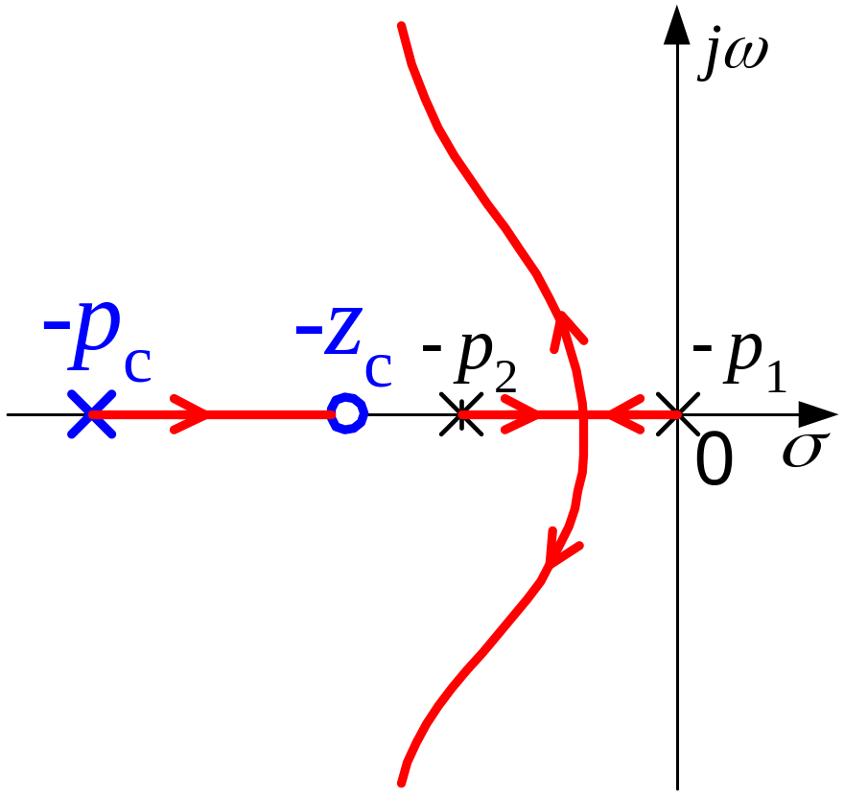
Adding a Leading Zero-Pole Pair
（1）
How about adding the pair to other positions?

Slide 14

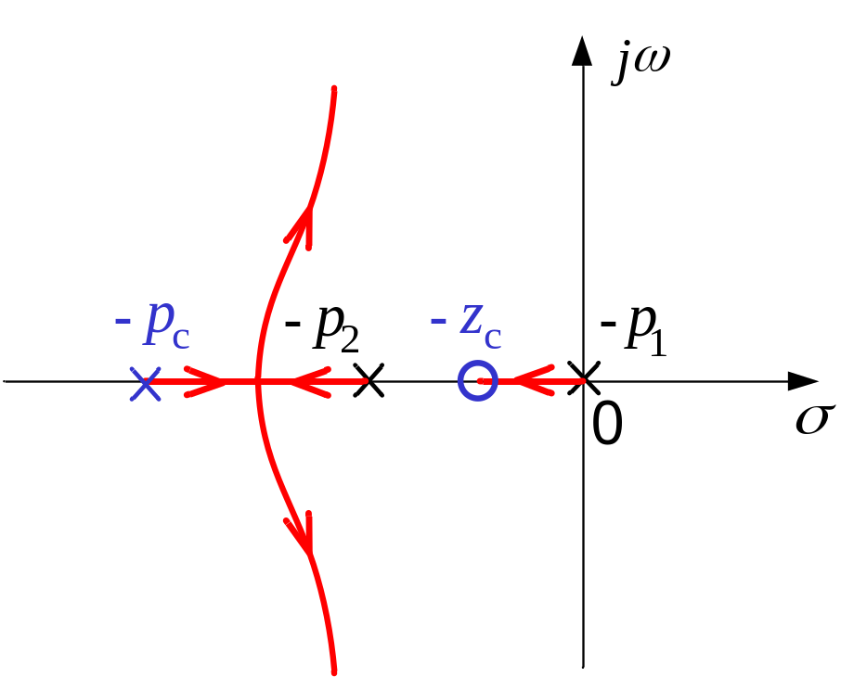
Adding a Leading Zero-Pole Pair
（2）

Slide 15

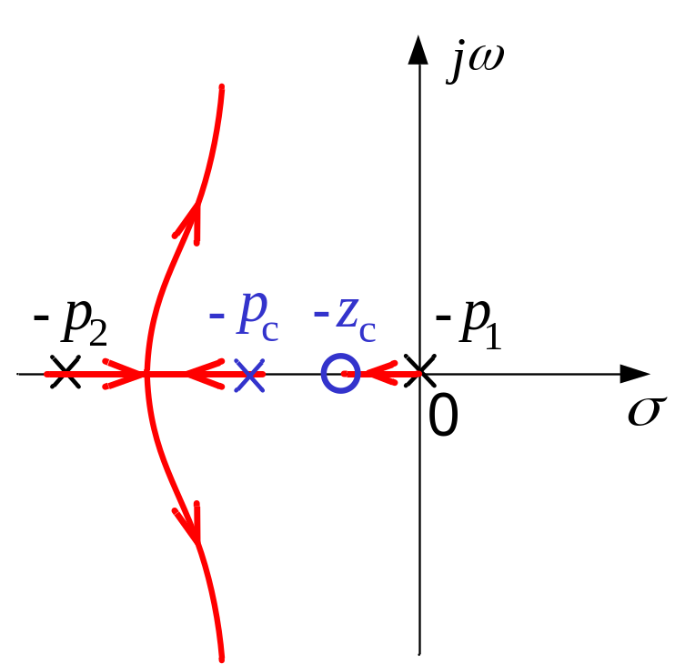
Adding a Leading Zero-Pole Pair
（3）

Slide 16

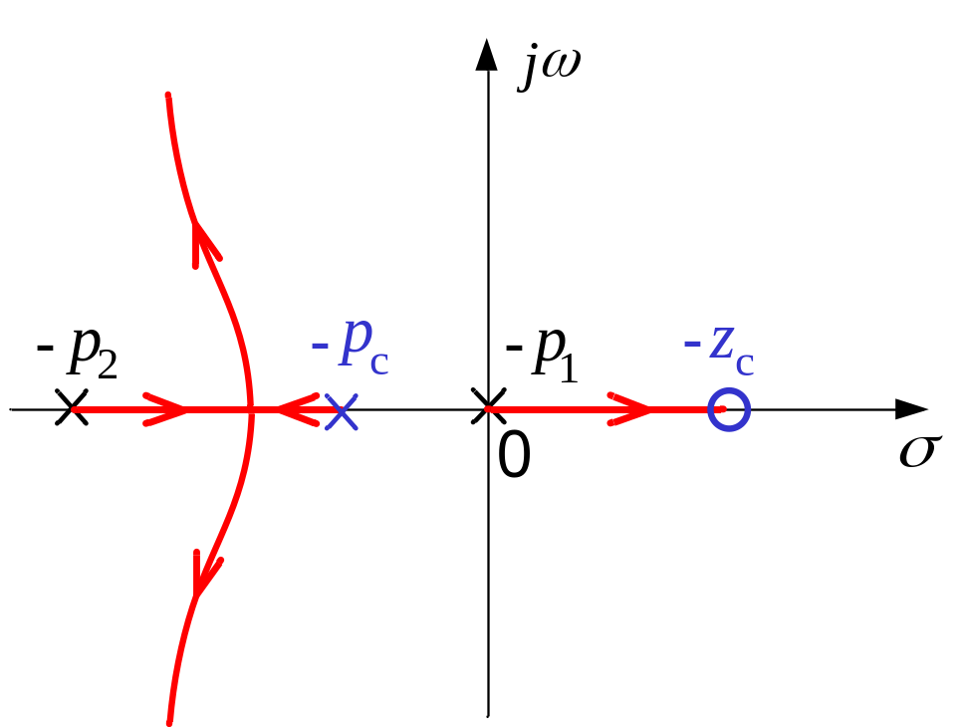
Adding a Leading Zero-Pole Pair
（4）

Slide 17

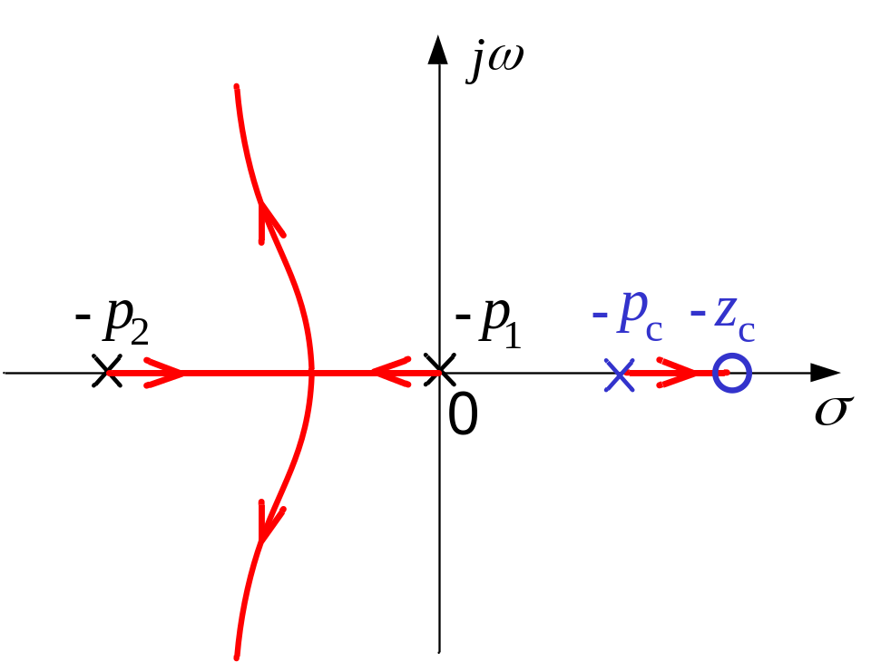
Adding a Leading Zero-Pole Pair
（5）

Slide 18



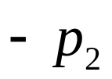
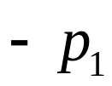
Adding a Lagging Zero-Pole Pair
（1）
How about adding the pair to other positions?

Slide 19

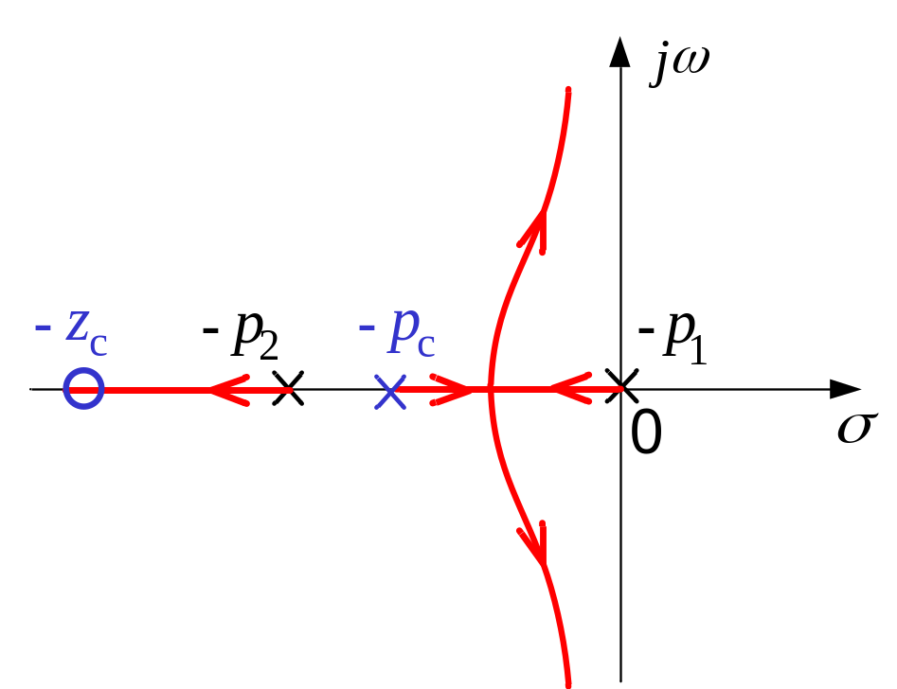
Adding a Lagging Zero-Pole Pair
（2）

Slide 20

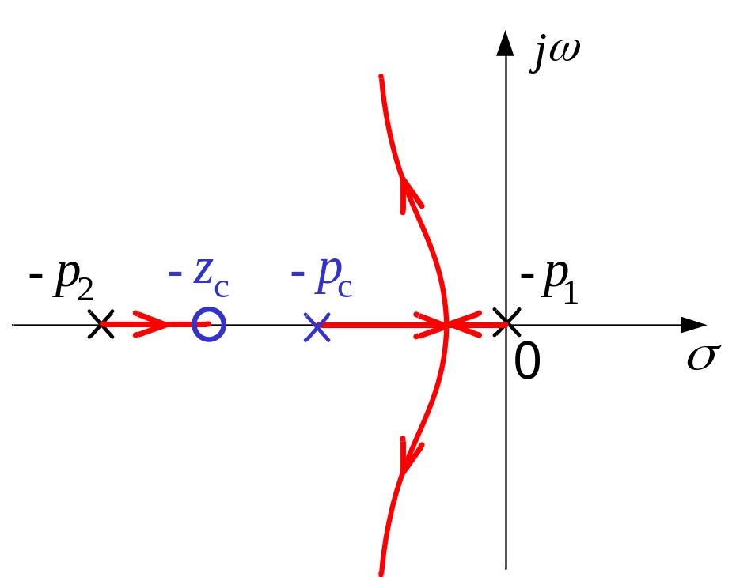
Adding a Lagging Zero-Pole Pair
（3）

Slide 21

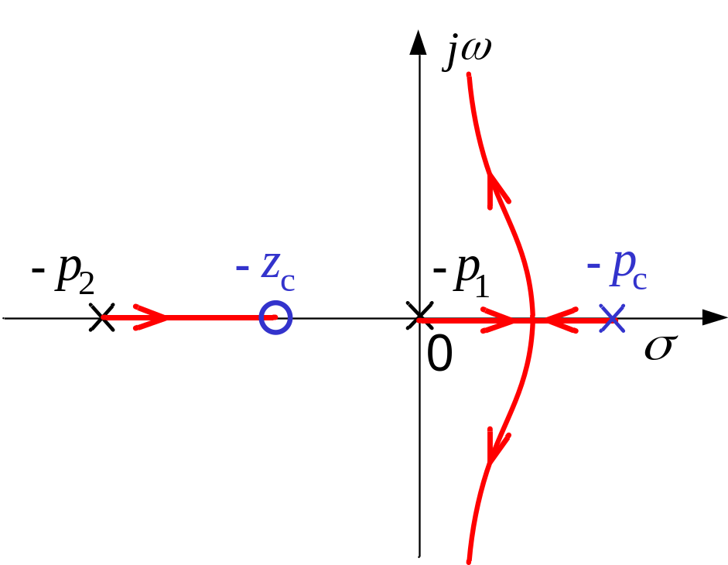
Adding a Lagging Zero-Pole Pair
（4）

Slide 22

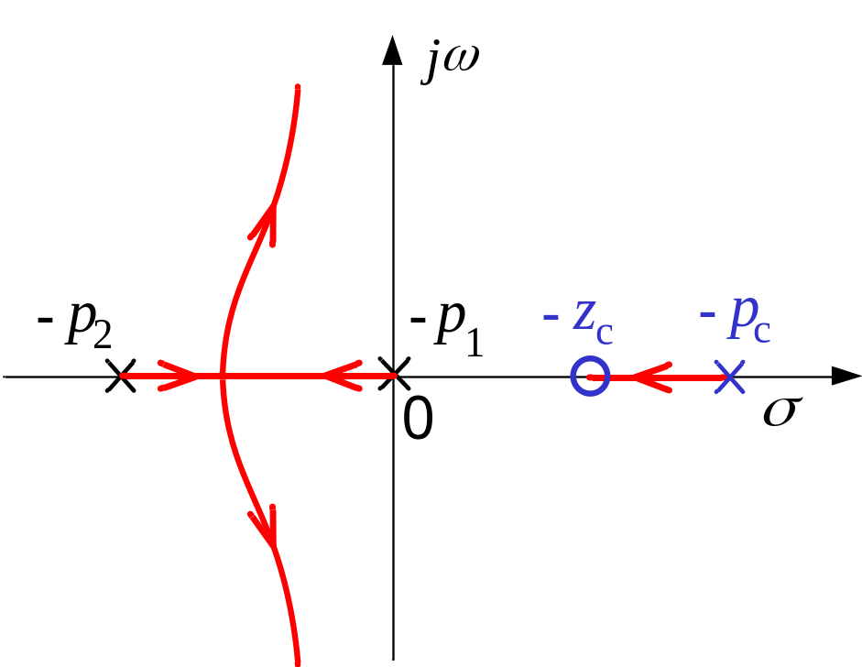
Adding a Lagging Zero-Pole Pair
（5）

Slide 23
Adding a Lagging Zero-Pole Pair Close to the Origin
j
ω
-
p
-
p
-
z
-
p
-
p
c
3
2
1
c
0
σ
0

Slide 24
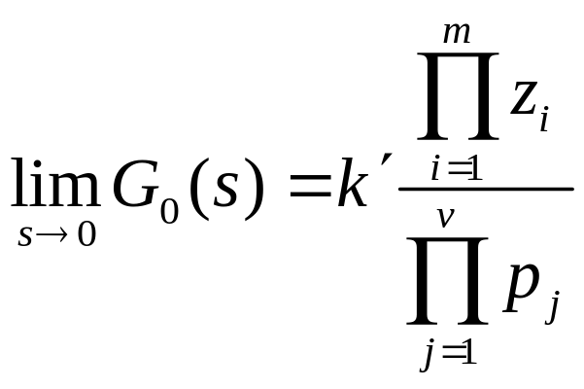
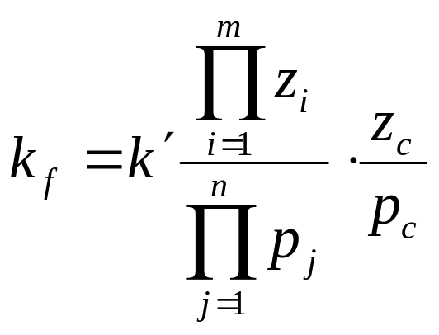

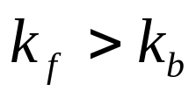
Adding a Lagging Zero-Pole Pair Close to the Origin
Step-error constant
Adding a lagging zero-pole pair close to the origin can decrease the
steady-state error of a type-zero system.

Slide 25
Wrap-up for root loci
Purposes of introducing root loci
Conditions and rules for constructing root loci
Expended usages of root loci method

Slide 26
Frequency-Domain Analysis of Control Systems
chapter 4

Slide 27
Review of Time Domain Analysis
Basics about time response
Stability definition and criterion
Steady-state and transient performance
Root locus

Slide 28
Outlines
Basics about frequency domain analysis
Polar plot of the frequency response of a system
Nyquist plot
Nyquist criterion(introduction)

Slide 29
Introduction
What is frequency response?
  the frequency response of a system is defined as the steady-state response of the system to a sinusoidal input signal
What is frequency-domain analysis
  Study the response characteristics of a system to sinusoidal waveform inputs of different frequencies.

Slide 30



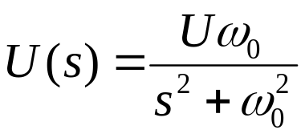
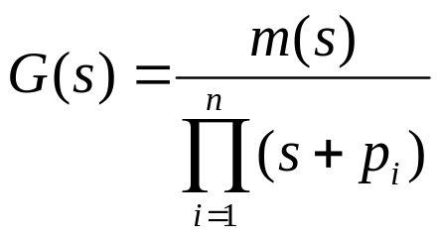

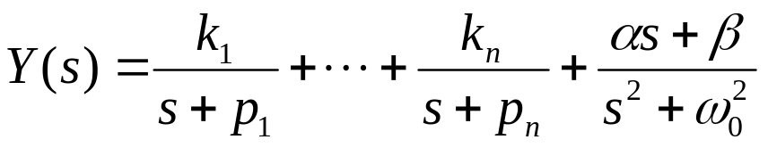
Introduction (Continue)
Consider a system response , the input is sinusoidal
with amplitude U and frequency
The Laplace transform of the input is
Assume
where are assumed to be distinct poles. Then in partial fraction
form we have

Slide 31
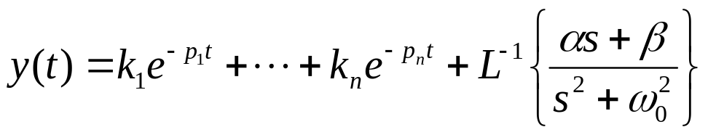



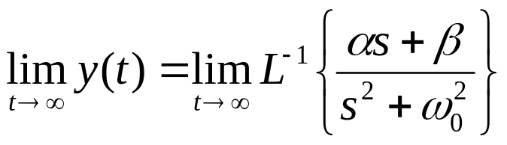

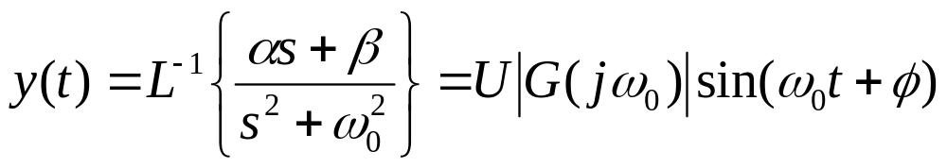

Introduction (Continue)
Taking the inverse Laplace transform yields
where and are constants which are problem dependent. If
the system is stable, then all have negative nonzero real parts,
and
for

Slide 32




Introduction (Continue)
If the input to a linear time-invariant system is sinusoidal with
amplitude U and frequency
the steady-state output of the system, , will be a sinusoid
with the same frequency , but possibly with different amplitude
and phase; that is
When the frequency of the input sinusoid changes, the amplitude
and phase shift of the output change with it.
G

Slide 33



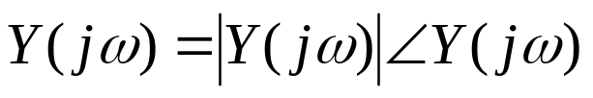


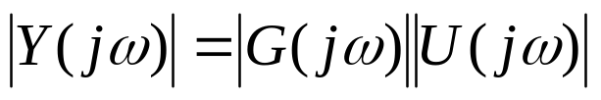

Introduction (Continue)
Obviously, the changes of the output are determined by the internal
characteristics of the system. The characteristics can be obtained by
the transfer function of the system.
For sinusoidal steady-state analysis, we replace s by ,
By writing the function as
with similar definitions for and , we can get the magnitude
and phase relation between the input and the output

Slide 34
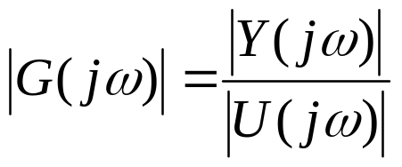

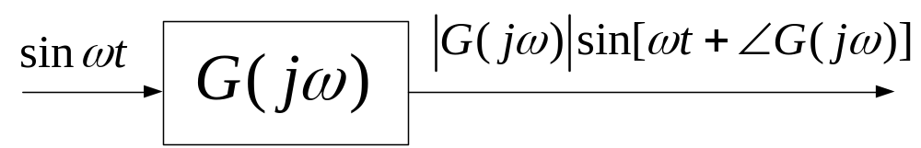

Introduction (Continue)
The magnitude-frequency relation of the system is
The phase-frequency relation of the system is
The above two relations can be gotten by measurement

Slide 35
Introduction
Why frequency-domain analysis?
  Advantages
    Very clear physical fundamentals;
    Ready availability of sinusoid test signals;
    A wealthy of graphical methods not limited to low-order systems;
    More convenient for measurements of system sensitivity to noise and parameter variation;
    Presents an alternative point of view to control system problem.
  Disadvantages
    Only applicable to LTI system;
    Hard to get accurate time-domain performance criteria

Slide 36

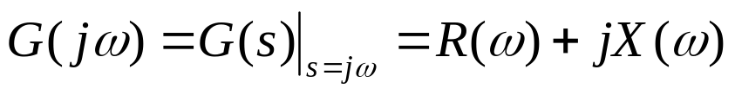
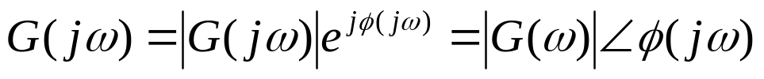
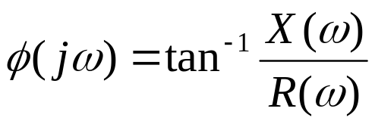
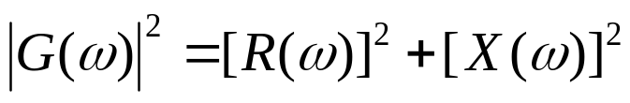
Frequency Response Plots
The transfer function of a system can be described in the frequency
domain by the relation
where and
Alternatively the transfer function can be represented by a magnitude
and a phase as
where and
The polar plot are usually used to graphically represent the frequency
response of the system. The coordinates of the polar plot can be obtained
from the above equations.

Slide 37




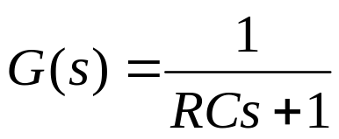
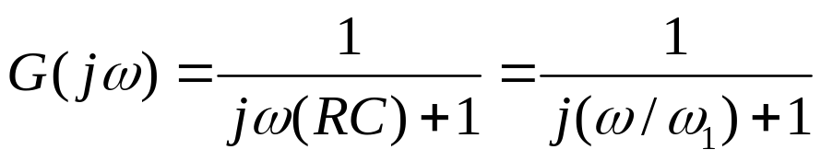
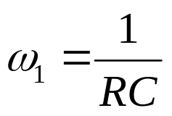
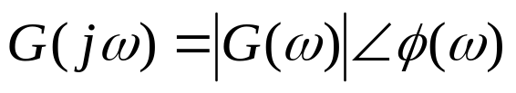
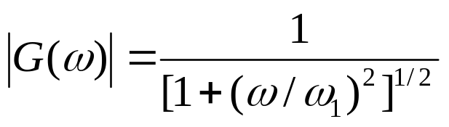

Example 1
Q: Construct the polar plot of the frequency response of the RC circuit
A: the transfer function is
The sinusoidal steady-state transfer function is
where
In magnitude-angle form

Slide 38







Example 1
Negative
Positive

Slide 39
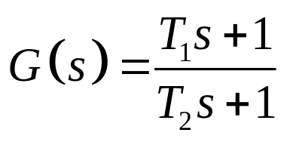
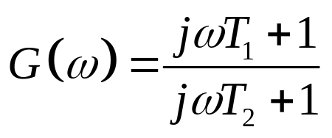
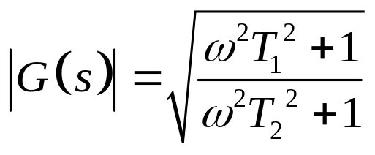
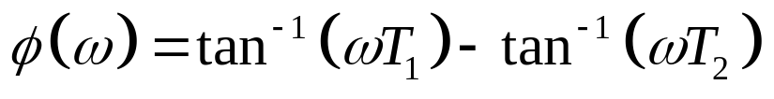
Example 2
Q: Construct the polar plot of the frequency response of the following
transfer function
A:
The sinusoidal steady-state transfer function is
In magnitude-angle form

Slide 40




Example 2
Case 1:
Positive
Negative

Slide 41

Example 2
Case 2:
Negative
Positive

Slide 42
Stability Analysis
Question: (1) How to analyze the stability of a
system in frequency domain?
(2) Do we have any convenient tools
to do that?
Nyquist Criterion

Slide 43




Nyquist Stability Criterion: Fundamentals
Encircled
B
A point or region in a complex function plane is said to be encircled by a closed path if it is found inside the path
A

Slide 44
Nyquist Stability Criterion: Fundamentals
B
Enclosed
A
A point or region is said to be enclosed by a closed path if it is encircled in counter clockwise (CCW) direction, or the point or region lies to the left of the path when the path is traversed in the prescribed direction.
B
A

Slide 45
Nyquist Stability Criterion: Fundamentals
B
B
A

Slide 46



Nyquist Stability Criterion: Fundamentals
Number of Encirclements
and Enclosures
A
B
When a point is encircled by a closed path , a number N can be assigned to the number of times it is encircled. The magnitude of N can be determined by drawing an arrow from the point to any arbitrary point on the closed path and then let follow the path in the prescribed direction until it returns to the starting point. The total net number of revolution traversed by the arrow is N, or the net angle is radian.
A
B

Slide 47




Nyquist Stability Criterion: Fundamentals
Principle of Argument
Let be a single-valued function that has a finite number of poles in the s-plane. Suppose that an arbitrary closed path is chosen in the s-plane so that the path dose not go through any one of the poles or zeros of ; the corresponding locus mapped in the -plane will encircle the origin as many times as the difference between the number of zeros and poles of that are encircled by the s-plane locus
Domain of definition
Valued field

Slide 48
Nyquist Stability Criterion: Fundamentals

Slide 49


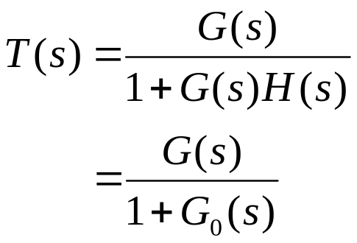


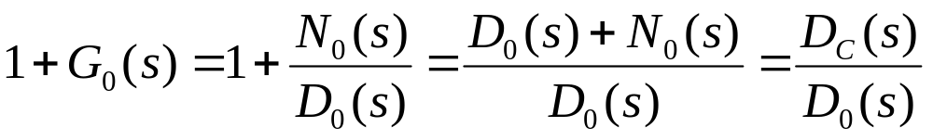
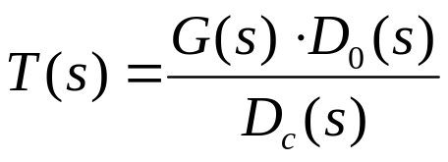

Stability Related
+
-
closed-loop transfer function poles: roots of the characteristic equation
zeros of
Stability condition: zeros of are all in the left-half s-plane

Slide 50





Nyquist Path
Nyquist path is the s-plane locus
that encircles the entire right-half
s-plane.
poles of
The Nyquist path does not go through
any poles or zeros of the concerned
function of s.
CCW is assigned as the positive
direction

Slide 51



Nyquist Criterion
Set
when s varies along the Nyquist path,
a corresponding locus is gotten in the f(s)-plane
f(s)-plane
s-plane
f’(s)-plane
(-1,j0)
1
Nyquist path
Nyquist plot
(-1,j0) is the critical point

Slide 52



Nyquist Criterion
The application of the Nyquist criterion to the stability problem involves
the following steps:
Define the Nyquist path in the s-plane;
Draw the plot in the plane;
The number of encirclements of the (-1,j0) point made by is
observed;
The Nyquist criterion follows the principle of argument
N=Z-P
where
N = number of encirclements of the (-1,j0) point made by the
plot
Z = number of zeros of that are inside the Nyquist path
P = number of poles of that are inside the Nyquist path

Slide 53

Nyquist Criterion
N=Z-P
N = number of encirclements of the (-1,j0) point made by the plot
Z = number of zeros of that are inside the Nyquist path
P = number of poles of that are inside the Nyquist path
For closed-loop stability, Z must equal zero

Slide 54

Nyquist Criterion
Thus the condition of stability according to the Nyquist criterion is
stated as
N=-P
For a closed-loop system to be stable, the plot must encircle
the (-1,j0) point as many times as the number of poles of that
are in the right-half s-plane, and the encirclement, if any, must be
made in the clockwise direction (if is defined in the CCW
sense).
If the open-loop system is stable, the plot should not encircle
the (-1,j0) point.
N=0

Slide 55











Example 4.1
Q: Sketch the Nyquist plot of the system with the following open-loop
transfer function and analyze the stability of the closed-loop system.
where
A: substitute in
substitute in
substitute in

Slide 56










Example 4.1
analyze the trend of when varies from 0 to
monotonically decreases
from K to 0
varies from 0 to 180 degree
Im
Re

Slide 57
Example 4.1
Im
negative frequency
Re
positive frequency
N=0, P=0, so Z=0, system stable.

Slide 58

Example 4.1
Nyquist plot sketched by Matlab
s=tf('s');
g=10/((s+1)*(2*s+1));
nyquist(g);

Slide 59
Wrap-up
Principle of argument
Nyquist plot
Nyquist criterion(introduction)

Slide 60
Assignment
Page 104
1,(5),(6)

Slide 61


Discussion
When Nyquist path comes across pure imaginary poles or zeros of , can we just let the path go around those poles and zeros from the left side of the imaginary axis?

